Slide 1

KD24103 Statistics and Data Analysis
Title: Examining Factors that affect Airline Passenger Satisfaction by using machine learning algorithm
Name | Matric Number
Lim Hong Yao | BI20110046
Lim Min Xuan | BI20110134
Peter Chin Meng Meng | BI20110111
Tuen Yong Hao | BI20110060
Lecturer: Dr. Ervin Gubin Moung
Notes:
Good Morning dr and my fellow coursemates, my name is yong hao, from group 11. Our project title is about …….. . Before I proceed to the next session, I would like to introduce my group mates first. My group consists of total of 4 members which are me, lim hong yao, lim min xuan, and peter chin meng meng. Without further ado, I will pass the time to hong yao and the floor is yours.

Slide 2








OUR TEAM
Lim Hong Yao
Peter Chin Meng Meng
aka Lala
aka Dipsy
Lim Min Xuan
Tuen Yong Hao
aka Po
aka Tinky Winky
Notes:
My group consists of 4 members which are me, lim hong yao, lim min xuan, and peter chin meng meng. Without further ado, I will pass the time to hong yao and the floor is yours.

Slide 3
INTRODUCTION

Slide 4
Why we pick this topic?
Growth in service began to accelerate in the 1960s and accelerated again after the double-dip recession in the early 1980
commerce ministry data, service sectors accounts for 60% to India’s GDP and 70% to Karnataka’s GDP
service sectors plays an important role in the global economy
How we know a service is good?

Slide 5
Problem statement
What are the most important attributes/factors in predicting airline passenger’s satisfaction?
What is the relationship between airline passenger’s satisfaction and service quality?

Slide 6
Objective
To investigate the prediction predicting airline passenger satisfaction for using machine learning algorithms.
To evaluate machine learning for airline passenger satisfaction.

Slide 7
Dataset Description
●URL link : https://www.kaggle.com/binaryjoker/airline-passenger-satisfaction
●The dataset record was published in 2015.
●The dataset is about the survey of passenger satisfaction in US airlines which is taken from the American Customer Satisfaction Index (ACSI) Travel Report : https://www.theacsi.org/industries/travel/airline

Slide 8
Dataset Description
●The dataset consists of 24 columns of variables.
●Response / Dependent variable ~ ‘satisfaction’
●Predictor variable / Independent variables :
‘Gender’, ‘customer_type’, ‘age’, ‘type_of_travel’, ‘customer_class’, ‘flight_distance’, ‘inflight_wifi_service’, ‘departure_arrival_time_convenient’, ‘ease_of_online_booking’, ‘gate_location’, ‘food_and_drink’, ‘online_boarding’, ‘seat_comfort’, ‘inflight_entertainment’, ‘onboard_service’ ‘leg_room_service’, ‘baggage_handling’, ‘checkin_service’, ‘inflight_service’, ‘cleanliness’, ‘departure_delay_in_minutes’, and ‘arrival_delay_in_minutes’

Slide 9
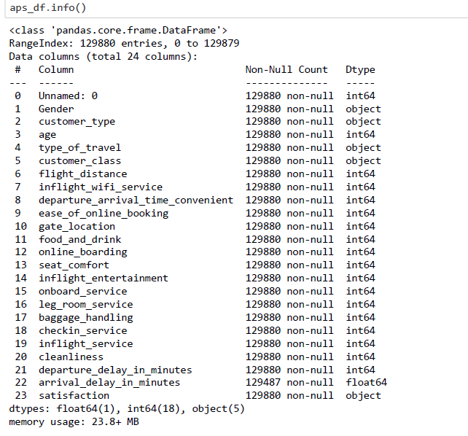
Notes:
To Peter

Slide 10
State-of-the-art
Notes:
Thank you Hong Yao. Good morning everyone, my name is Peter and I’m here to briefly explain our state of the art. Next slide please.

Slide 11
Application of Sentiment Analysis with Machine Learning Approaches
Sentiment analysis - method of extracting emotions from textual information.
Air passengers usually share their travel experiences on Twitter.
Using machine learning techniques, it reveals insights on the passenger’s degree of comfort from their textual information.
Model ended with 80+% accuracy, improvements can be made by including more tweets in the analysis.
Notes:
The first article that correlates to our project is this, application of sentiment analysis with machine learning approaches. To give everyone a heads up, sentiment analysis is a method of extracting emotions from textual information such as posts, feedbacks, and so on. Air passengers usually share their travel experiences on Twitter, therefore, by using the platform and machine learning techniques, it reveals the insights on the passenger’s degree of comfort from their textual information. The model ended with an whopping 80 percent accuracy and improvements can be made by including more tweets in the analysis. Next slide please.

Slide 12
Application of data-mining and analytics method on classifying the airline passenger satisfaction and loyalty.
Data mining - process of discovering meaningful patterns and trends in a large scale of data.
Data analytics - act of examining, cleaning, manipulating, and modeling data to find relevant information.
Decision tree and logistic regression algorithm is applied to identify characteristics of loyal passengers and also to compare accuracy of both models (Wong, J.-Y., & Chung, P.-H., 2008).
Decision tree - 82.6%, Logistics regression model - 82.5%
Notes:
The second article that correlates to our project that can be further referenced is this. Application of data mining and analytics method on classifying the airline passengers satisfaction and loyalty. For heads up once again, data mining is a process of discovering meaningful patterns and trends in a large scale of data, whereas data analytics is an act of examining, cleaning, manipulating, and modeling data to find relevant information. Based on the study of Wong and Chung at 2008, a decision tree and logistic regression algorithm is applied to identify characteristics of loyal passengers and also to compare accuracy of both models. In the end, decision tree was slightly higher in accuracy with 92.6 percent and a slight difference of 0.1 percent with logistics regression model. Next slide please.

Slide 13
cont.
Random Forest algorithm, Gradient Boosting Machine and Decision Tree are used to determine the most suitable algorithm for classifying the satisfactory level of airline passengers based on the overall ratings (Javed Parvez & Sahayadhas, 2020).
Random Forest algorithm - 92.7%, Gradient Boosting Machine - 94.6%
Notes:
Based on the study of Javed Parvez and Sahayadhas at 2020, a random forest, gradient boosting machine and decision tree model are used to determine the most suitable algorithm for classifying the satisfactory level of airline passengers based on the overall ratings. In the end, random forest algorithm and gradient boosting machine were higher in terms of accuracy than decision tree model with gradient boosting machine with the higher lead of 94.6 percent. So that’s all from state of the art, I shall now my pass my time back to Hong Yao for Methodology.

Slide 14

Methodology
Machine learning models

Slide 15
Data Pre-processing
Model Selection
Feature Selection
Model evaluation

Slide 16
Data Pre-processing
01
Remove unnecessary feature/attribute
02
Identifying missing value
The dataset is checked and determined with the NaN value by using the isna().sum() and dropna() function
the variable ‘Unnamed: 0’ which represents airline passenger ID is removed
03
Encoding the feature/attribute
The feature/attribute is encoded by using the one hot encoding, dummy encoding and ordinal encoding.

Slide 17
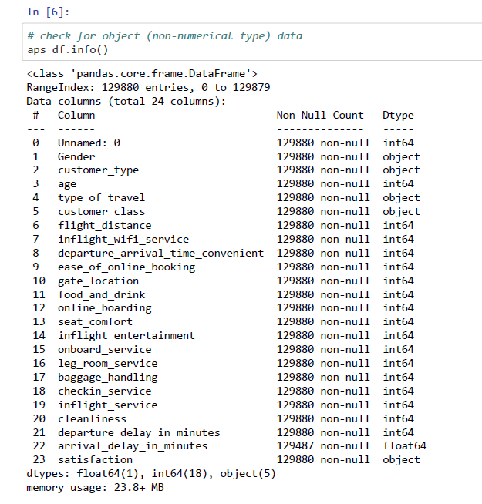
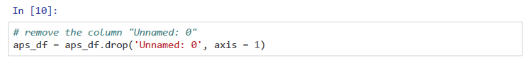
01 Remove unnecessary feature/attribute

Slide 18
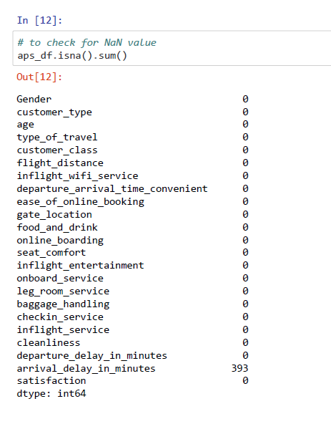
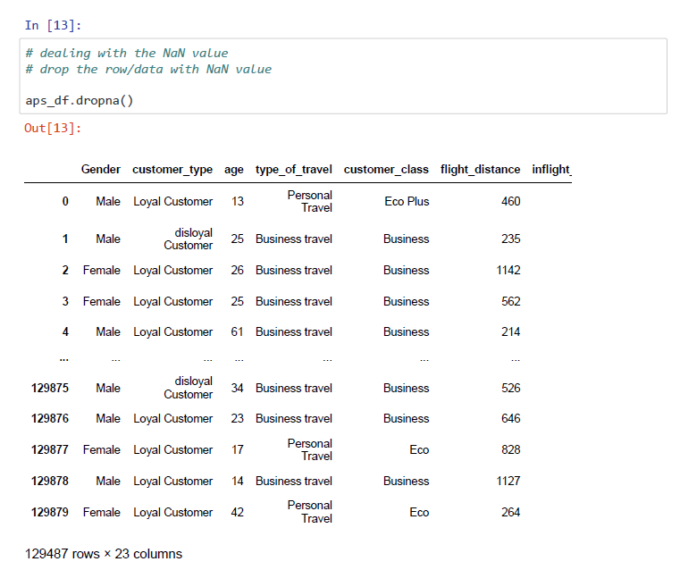
02 Identifying missing value

Slide 19
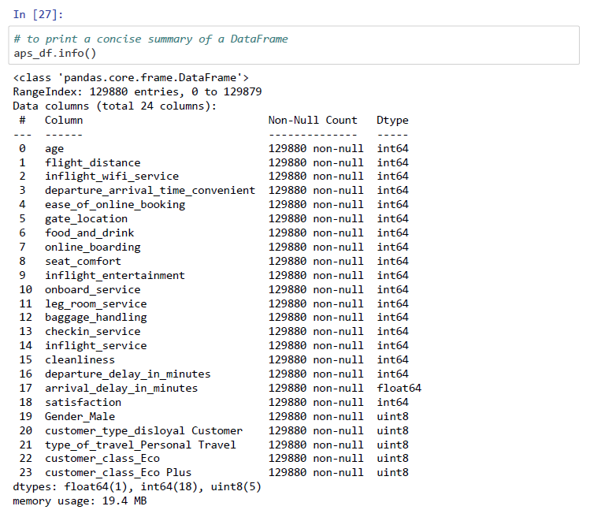
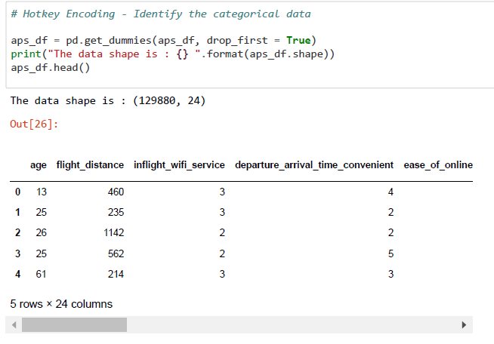
03 Encoding the feature/attribute
One Hot Encoding - encode the object type features into integer type
Notes:
A one hot encoding is a representation of categorical variables as binary vectors.This first requires that the categorical values be mapped to integer values. Then, each integer value is represented as a binary vector that is all zero values except the index of the integer, which is marked with a 1
To Min Xuan
https://machinelearningmastery.com/how-to-one-hot-encode-sequence-data-in-python/

Slide 20
Encoding object type variable into integer type
Dummy Encoding
Ordinal encoding
Neptune
Mars
Neptune is the farthest planet from the Sun
Despite being red, Mars is a cold place, not hot
Notes:
Dummy and ordinal encoding techniques are also applied during dataset preparation for the gradient boosting machine learning algorithm.
Dummy encoding technique is applied on the object type independent variables such as gender, customer type, type of travel and customer class whereas the ordinal encoding technique is applied on the object type target variable which is satisfaction.The reason of using different encoding techniques is to ensure the target variable column would not be encoded into two columns by using dummy encoding technique.

Slide 21
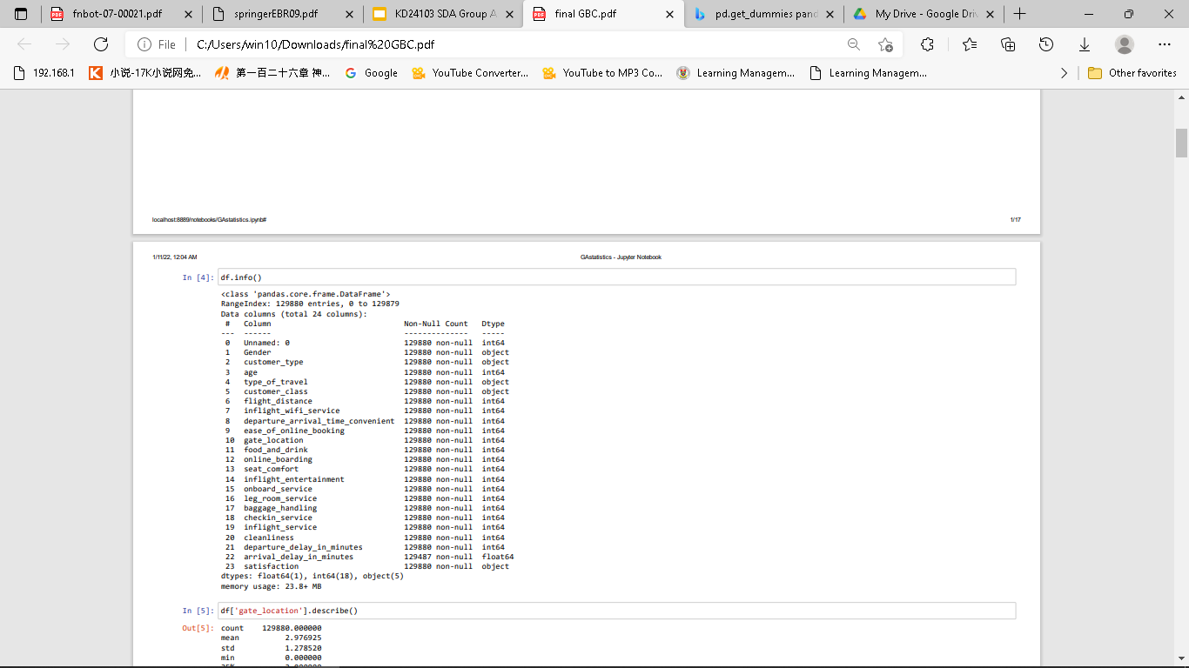
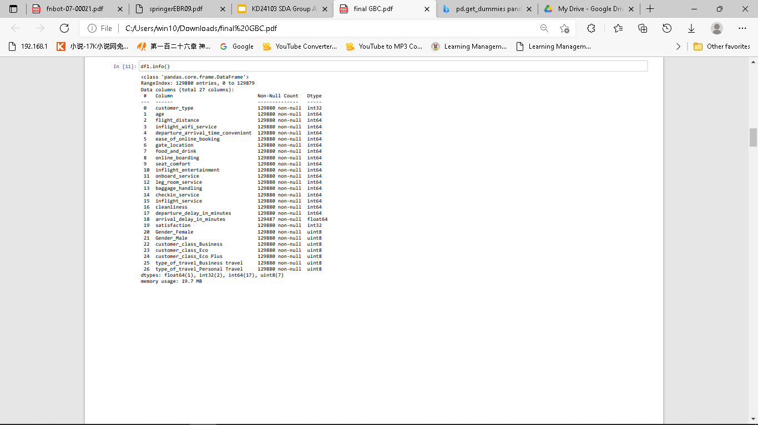
Dummy and Ordinal Encoding - Encoding object type variable into integer type
Notes:
Here are two different description of the datasets. The left figure illustrate the original dataset and the right figure shows the encoded dataset by applying the dummy and ordinal encoding techniques.
To Hong Yao

Slide 22
01
Random Forest
To study whether the passenger to satisfied or not
Is a 1 and 0 ( Categorical variable)

Slide 23
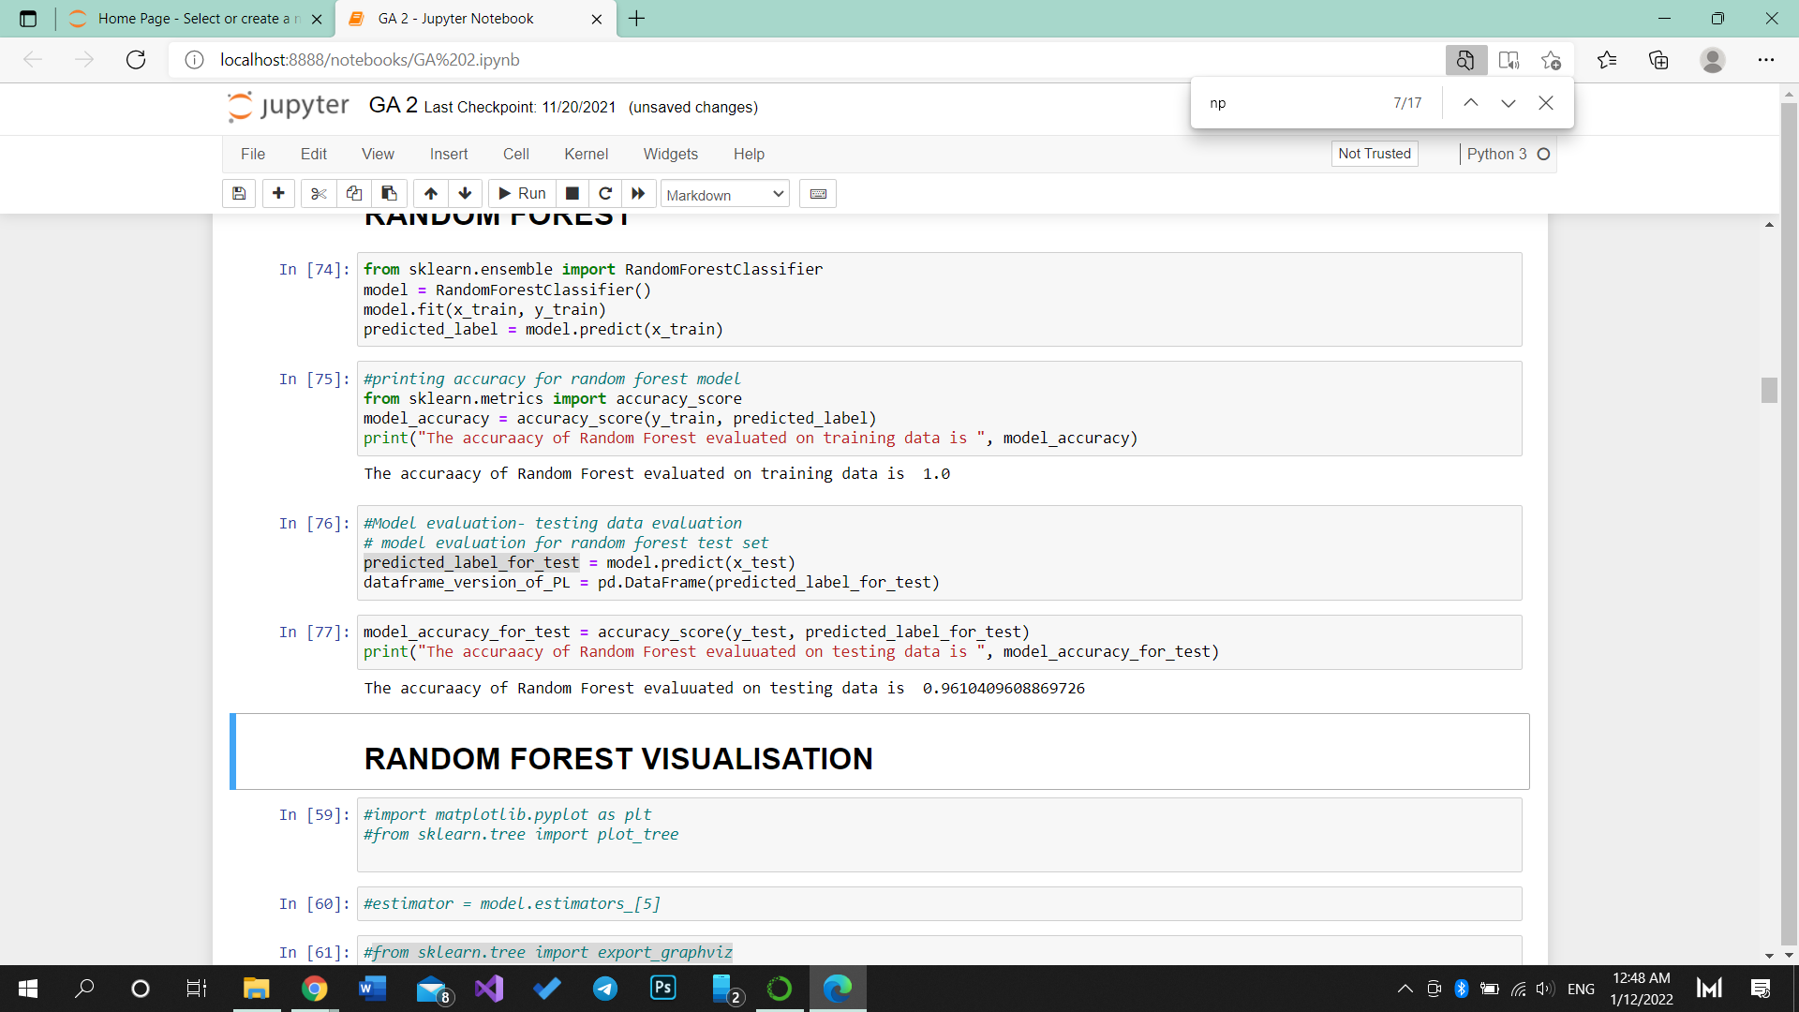
Random Forest
The codes above shows the accuracy of Random Forest model using training sets
Notes:
Result - visual, model, evaluation

Slide 24
Random Forest
The codes above shows the accuracy of Random Forest model using testing sets
Notes:
To Yong Hao

Slide 25
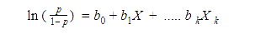
02
Logistic Regression
0

Slide 26
Logistic Regression
is a regression model that models the probabilities for classification problems with two possible outcomes
use logistic functions to squeeze the output of linear equations between 0 and 1
validity checking of the dataset is performed to meet three key assumptions which are appropriate outcome type, linearity of independent variables and log-odds, and absence of multicollinearity
the two unique outcomes in the dependant variable ‘satisfaction’ which are ‘satisfied’ and ‘neutral/dissatisfied’. In this case, we may use binary logistic regression.
check for linearity between the predictor variables and the logit (logarithm of the odds ratio). Since logistic regression model does not need a linear relationship between the dependent and independent variables, but it still needs independent variables to be linearly related to the log-odds of the outcome.
By generating the correlation matrix heatmap, the presence of multicollinearity could be determined.
Notes:
In order to apply LR model, …..
correlation greater than 0.9 or less than -0.9 is to be avoided.There is no multicollinearity found in the advertising dataset.
A simple way to detect collinearity is to look at the correlation matrix of the predictor

Slide 27
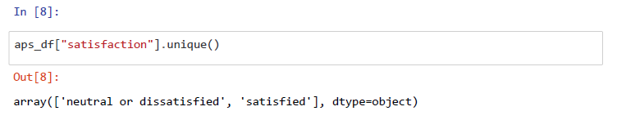
Logistic Regression
Appropriate outcome type
the two unique outcomes in the dependant variable ‘satisfaction’ which are ‘satisfied’ and ‘neutral/dissatisfied’.

Slide 28
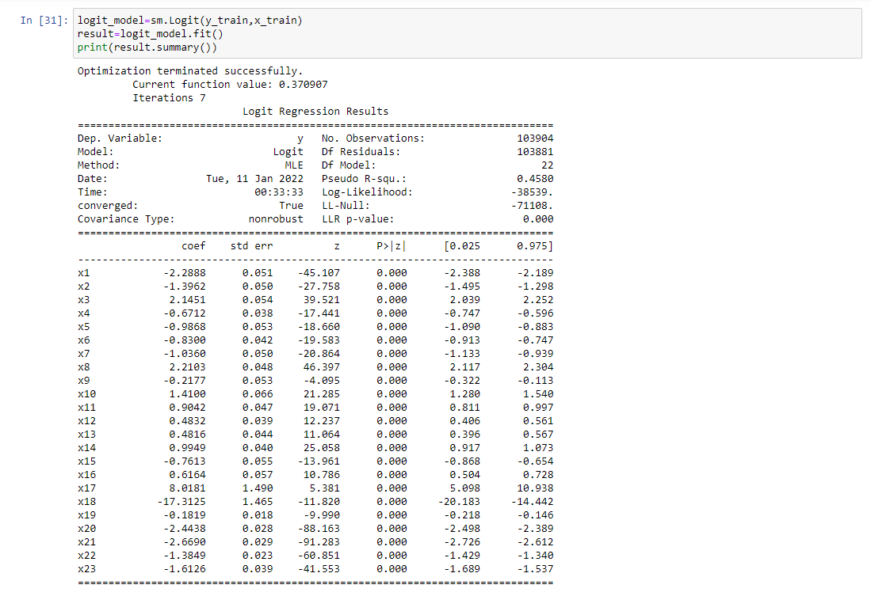
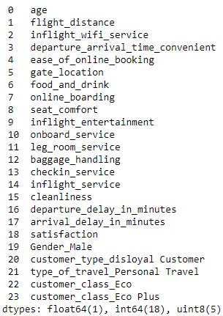
Linearity of independent variables and log-odds
Logistic Regression
check the statistical significance of the interaction terms based on their p-values.
Notes:
From the analysis, the p-value, which is the probability of finding the given test statistic if the null hypothesis of no relationship were true, is highly regarded to indicate whether the model fits the data well. A model whose p-value is closer to 0 will fit the data well

Slide 29
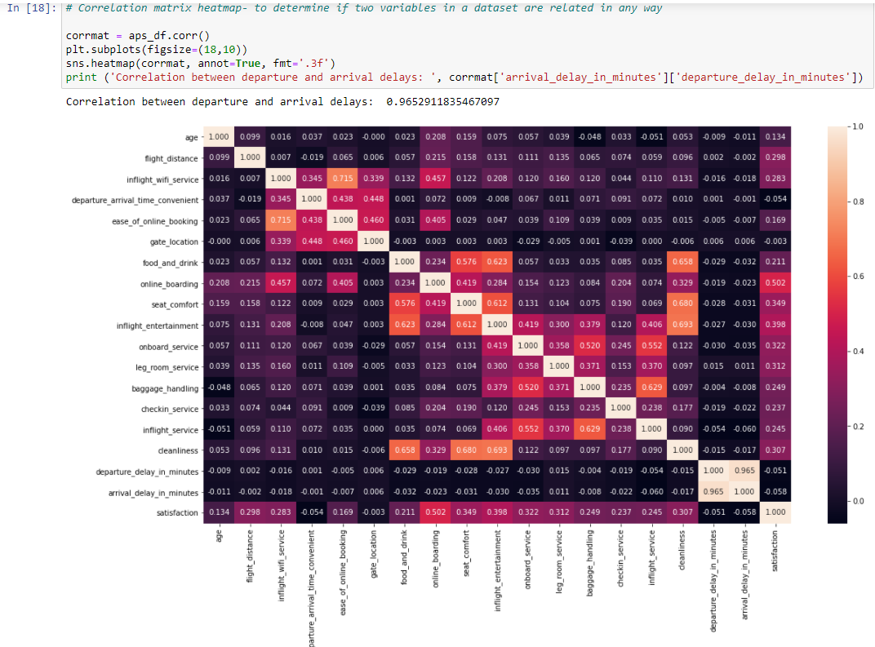
Logistic Regression
Absence of multicollinearity
Correlation greater than 0.9 or less than -0.9 is to be avoided.
There is no multicollinearity found in the dataset.
A simple way to detect collinearity is to look at the correlation matrix of the predictor
Notes:
To Min Xuan

Slide 30
03
Gradient Boosting Classifier

Slide 31
About Gradient Boosting Machine (GBM)
Support in making both regression and classification task.
Construct the new base-learners to be maximally correlated with the negative gradient of the loss function
Base-learners generated from training data by a base learning algorithm
In this study, we will apply the GBM for the prediction of satisfaction instead of conducting a deep research on GBM
Reason to apply the GBM classifier:
Some related studies showed a good prediction result by adopting the gradient boosting algorithm. (Javed Parvez, S., & Sahayadhas, A. (2020))

Slide 32
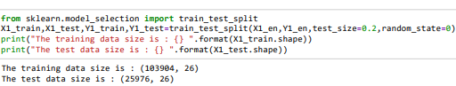
Splitting Dataset
Splitting encoded dataset into 80% of training dataset and 20% of testing dataset
Notes:
After ensure all of the variables of the dataset are integer types,the encoded dataset will be further separated into 80% of training dataset for the model training purpose and 20% of testing dataset that used for model evaluation purpose.

Slide 33
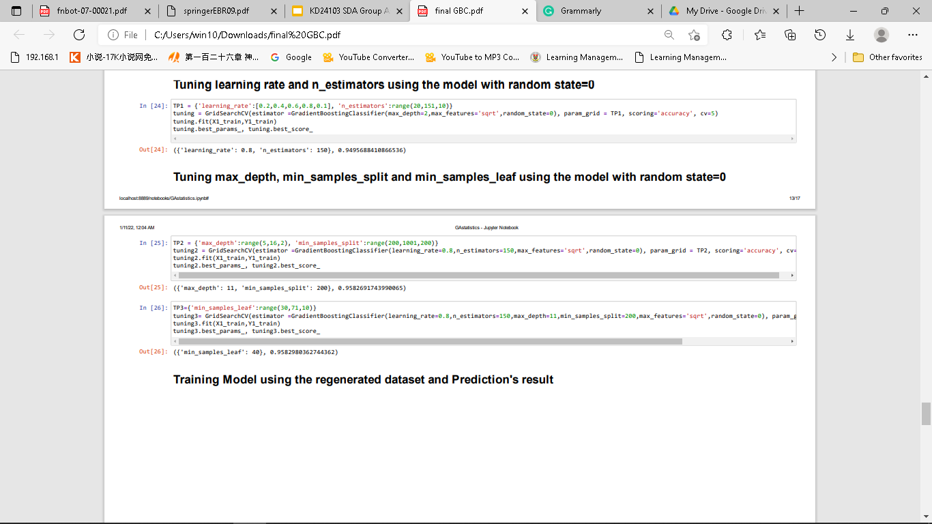
Model’s Parameter Tuning
Notes:
Besides that,the tuning process on five main parameter of the gradient Boosting classifier which are learning rate,n_estimators,maxdept,min of the samples split and minimum leaves of the samples will be performed before begin to train the model. The objective of tuning the parameters is to increase the prediction accuracy of the model that will be build later and avoid the overfitting result at the same time.

Slide 34
Results
Notes:
To Hong Yao

Slide 35
Result
Random Forest
The codes above shows the accuracy of Random Forest model using training sets
Notes:
Result - visual, model, evaluation

Slide 36
Result
Random Forest
The codes above shows the accuracy of Random Forest model using testing sets
Notes:
Result - visual, model, evaluation

Slide 37
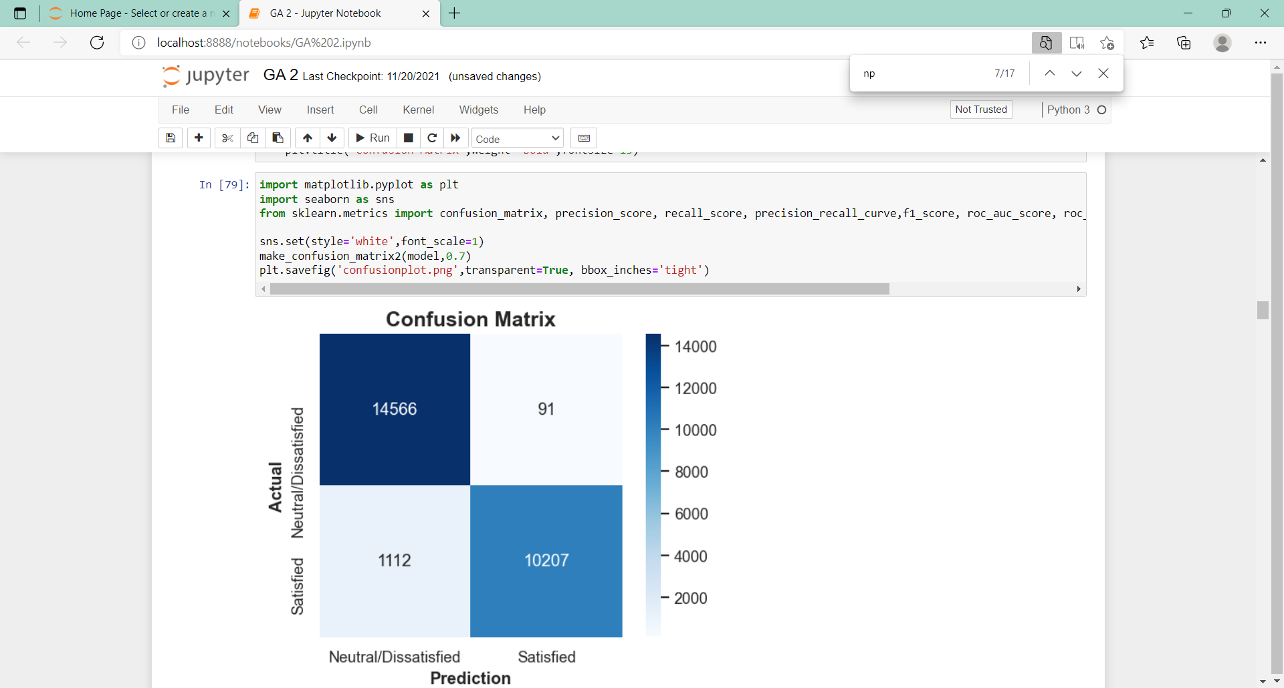
Random Forest
Confusion matrix
Precision = TP/ (TP + TN)
Notes:
Confidence, true tp,tf
10207+ 14566 = correct pridiction

Slide 38
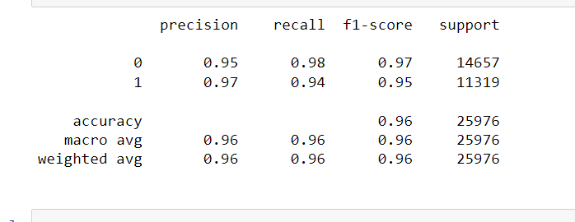
Result
Random Forest
Notes:
precision

Slide 39
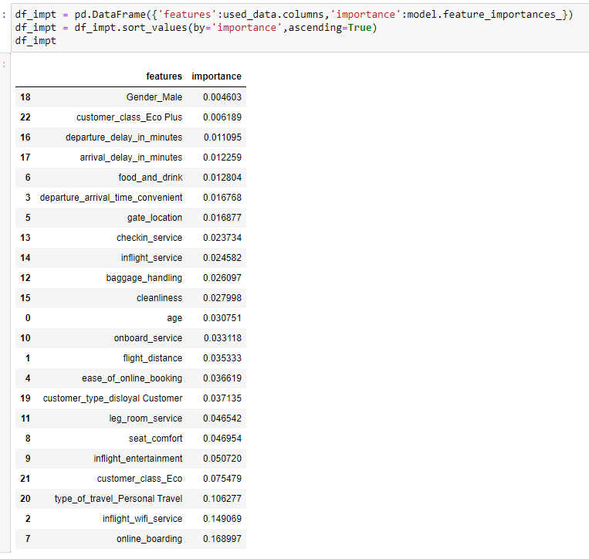
Result
Random Forest
This codes shows which attribute in the dataset affect the model.
Assign scores based on the input features
Indicate how useful of the attribute in prediction
Notes:
Important feature

Slide 40
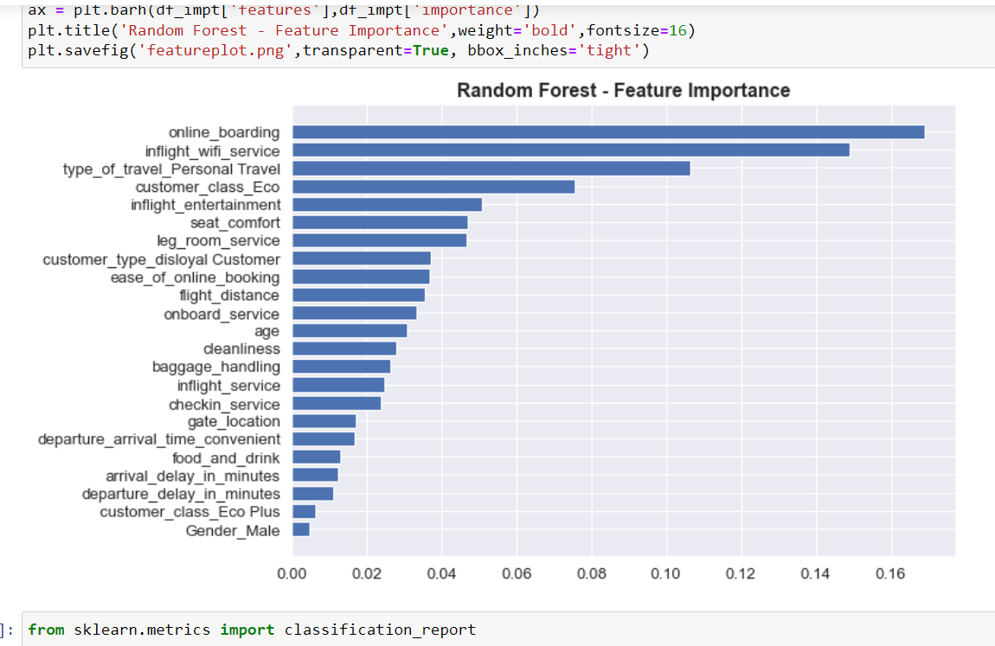
Visualisation for important features
Random Forest
Notes:
Important feature - To Yong Hao

Slide 41
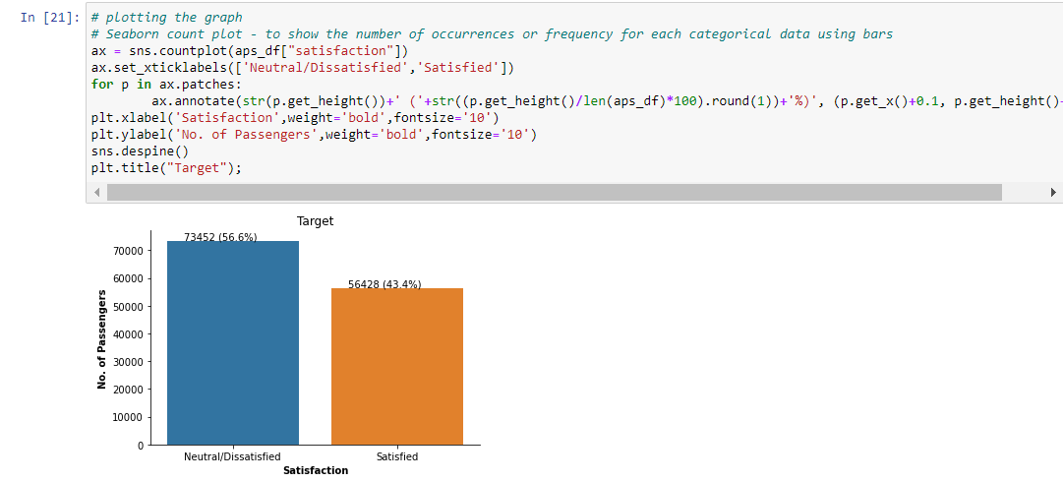
Result
Logistic Regression
By plotting the graph, 56.6 % of passengers reporting Neutral / Dissatisfied (negative class: 0) and 43.4 % reporting Satisfied, the target class is equally balanced (positive class: 1).

Slide 42
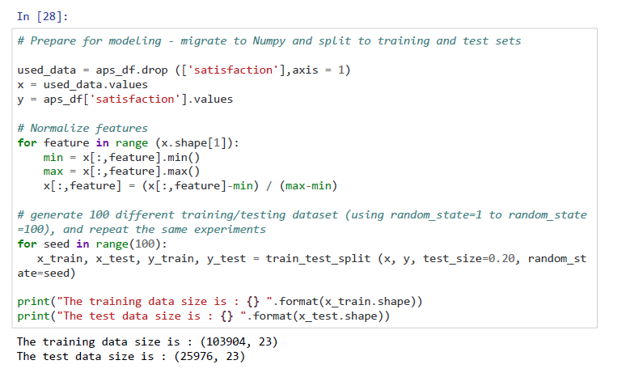
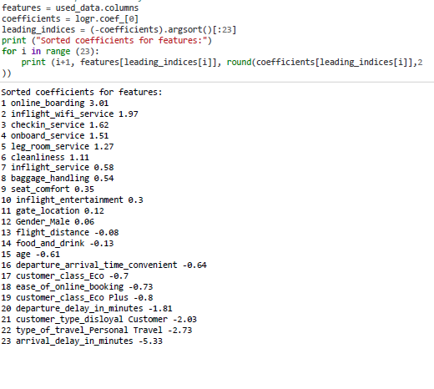
Logistic Regression
Result
the dataset is normalized and randomly divided into two datasets for training and testing purposes with ratios of 80% and 20% respectively.
There are 3 features which stand out: online_boarding (3.01), inflight_wifi_service (1.97), and checkin_service (1.62). At the same time, the other features have a coefficent below 0.3 in absolute value, so they are consider less important.

Slide 43
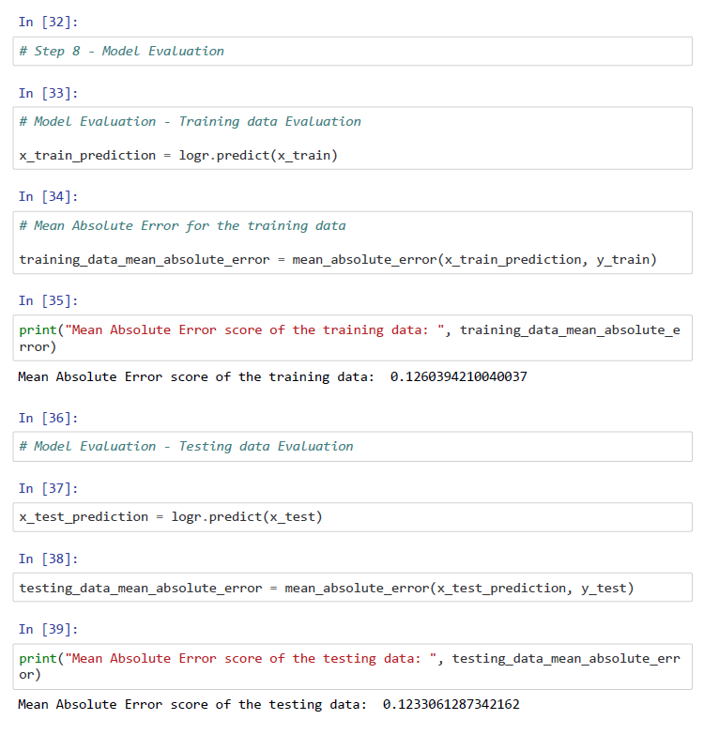
Result
Logistic Regression
In the model evaluation, MAE is used to measure only the magnitude of the errors and doesn’t concern itself with their direction. The lower the MAE, the higher the accuracy of a model.

Slide 44
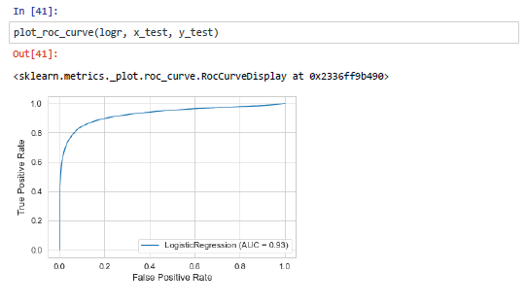
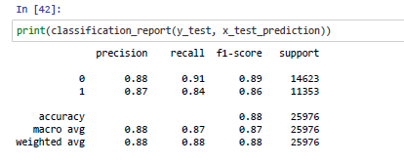
Logistic Regression
Result
Classification report is used to show the precision, recall, f1-Score, and support.
AUC-ROC curve helps us visualize how well the logistic regression is performing. The area under the ROC curve (AUC) of logistic regression is 0.93. The result was considered excellent for AUC values between 0.9-1.
Notes:
the Higher the AUC, the better the model is at distinguishing between airline passengers with satisfied and neutral/dissatisfied.
Classification report is a performance evaluation metric in machine learning model. It is used to show the precision, recall, f1-Score, and support of the trained classification model
https://towardsdatascience.com/understanding-auc-roc-curve-68b2303cc9c5
https://towardsdatascience.com/building-a-logistic-regression-in-python-step-by-step-becd4d56c9c8

Slide 45
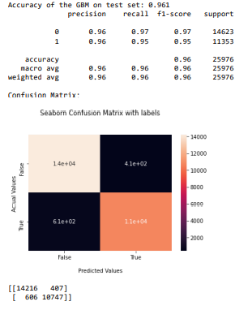
Result
Gradient Boosting classifier (GBC)
Precision = TP/(TP + FP)
Recall = TP/(TP + FN)
F1 Score = 2*[(precision*recall) / (precision+recall)]
Accuracy=(TP+TN)/(TP+FP+TN+FN)
Notes:
For the evaluation of the GBC model, the confusion table is created to review the performance of the model from 4 aspect which are precision,recall f1 score n accuracy.Precision is a measure of correctness that is achieved in true prediction.Recall is the measure of actual observations which are predicted correctly. F1 score is a number between 0 and 1 and is the harmonic mean of precision and recall.Accuracy simply measures how often the classifier makes the correct prediction

Slide 46
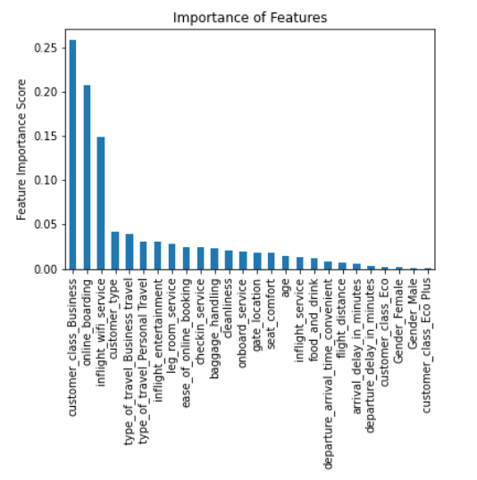
Result
Gradient Boosting classifier (GBC)
The bar chart of the importance of features show which kind of predictor variables will be significantly affect the model’s prediction
Notes:
Feature Importance refers to techniques that calculate a score for all the input features for a given model — the scores simply represent the “importance” of each feature. A higher score means that the specific feature will have a larger effect on the model that is being used to predict a certain variable.

Slide 47
Result
Gradient Boosting classifier (GBC)
The confusion table illustrated that the GBC could perform well on the prediction of airline passengers satisfaction based on the large dataset.
Notes:
Result - visual, model, evaluation

Slide 48
Results discussion
Notes:
Thank you Min Xuan, hi its me again. So now im here to explain the results discussion. Next slide please.

Slide 49
BASED ON THE RESULTS
ACCURACY
FEATURE IMPORTANCE
LOGISTIC REGRESSION
Neptune
Mars
Neptune is the farthest planet from the Sun
Despite being red, Mars is a cold place, not hot
Both Random Forest and GBC models obtained an accuracy of 96%.
Both Random Forest and GBC models had “online_boarding” and “inflight_wifi_service” as features of higher importance
Jupiter
shown that both features highly affects the overall performance of the regression model.
Jupiter is the biggest planet in the Solar System
Notes:
So based on the results from random forest, logistic regression, and Gradient boosting classifier. In terms of accuracy, both random forest and gradient boosting classifier models obtained an accuracy of 96%. This actually shows the dataset is very precise and accurate in terms of its variable. Moving on to feature importance, like accuracy, both random forest and gradient boosting classifier models had variables “online boring” and “inflight wifi service” as features of higher importance. Therefore, it can be concluded that these variables greatly influence how the classification goes, with these variables as true often results in one satisfied customer in an aircraft. Proving this, logistic regression also shown that both variables, which is “online boarding” and “inflight wifi service”, greatly affect the overall performance of the regression model with high coefficient value. So that is all from results discussion, next slide please.

Slide 50
Conclusion
Notes:
I shall now move on to last and final part of our presentation, conclusion.

Slide 51
Our study have reviewed some of the related articles that are focusing on the airline passenger satisfaction based on their consuming behavioral and the provided airline services
We adopted three different machine learning models (logistic regression, GBC and random forest) on predicting airline passengers satisfaction
GBC and random forest model were found that having the most similar but relatively high accuracy on predicting the passenger satisfaction
‘Online_boarding’ and ‘inflight_wifi_services’ as the most influencing services that positively affect the passengers satisfaction which is supported by three of the models built
Notes:
In conclusion,Our study have reviewed some of the related articles that are focusing on the airline passenger satisfaction based on their consuming behavioral and the provided airline services.In our study,We have applied three different machine learning models which are logistic regression, GBC and random forest on predicting airline passengers satisfaction.Based on our findings, the GBC and random forest model were found that having the highest accuracy on predicting the passenger satisfaction by comparing with the logistic regression. Moreover, we also found that the ‘Online_boarding’ and ‘inflight_wifi_services’ as the most influencing services that will positively affect the passengers satisfaction and this finding is supported by the three of the models built. Next slide please.

Slide 52

THANKS
Notes:
So that’s all from us, thank you!

Slide 53
Guideline
Include page number
Total presentation session: 30 minutes
Total presentation by group: max 15 minutes
Total Q & A session: 15 minutes
Wednesday - afternoon (rehearsal)
Notes:
Once you find your sources, you will want to evaluate your sources using the following questions:
Author:
Who is the author?
Why should I believe what he or she has to say on the topic?
Is the author seen as an expert on the topic? How do you know?
Current:
How current is the information in the source?
When was the source published?
Is the information out-of-date?
Accuracy:
Is the content accurate?
Is the information presented objectively? Do they share the pros and cons?

Slide 54
Outline
Introduction max 2 minutes (lawrence)
State-of-the-art max 2 minutes (Peter)
Methodology max 3 minutes (Logistic Regression, Gradient boosting classifier, Random Forest)
Results max 3~4 minutes (Logistic Regression, Gradient boosting classifier, Random Forest)
Results discussion max 3~4 minutes (Peter)
Conclusion max 2 minutes (min xuan)
Q & A with lecturer max 15 minutes
Notes:
Once you find your sources, you will want to evaluate your sources using the following questions:
Author:
Who is the author?
Why should I believe what he or she has to say on the topic?
Is the author seen as an expert on the topic? How do you know?
Current:
How current is the information in the source?
When was the source published?
Is the information out-of-date?
Accuracy:
Is the content accurate?
Is the information presented objectively? Do they share the pros and cons?

Slide 55
Dataset Description
●The dataset consists of 24 columns of variables.
●Response variable ~ ‘satisfaction’
●Predictor variable / Independent variables ~
‘Gender’, ‘customer_type’, ‘age’, ‘type_of_travel’, ‘customer_class’, ‘flight_distance’, ‘inflight_wifi_service’, ‘departure_arrival_time_convenient’, ‘ease_of_online_booking’, ‘gate_location’, ‘food_and_drink’ c, ‘online_boarding’, ‘seat_comfort’, ‘inflight_entertainment’, ‘onboard_service’ ‘leg_room_service’, ‘baggage_handling’, ‘checkin_service’, ‘inflight_service’, ‘cleanliness’, ‘departure_delay_in_minutes’, and ‘arrival_delay_in_minutes’
●Dataset named ‘air_passenger_satisfaction.csv’ is chosen for modelling.

